Slide 1
Linux basics and bash scripting
Part 2
Based on https://michael-herbst.com/teaching/advanced-bash-scripting-2017/

Slide 2
Control structures and
Input/Output
Part 4

Slide 3
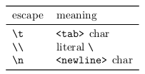
Printing output with echo
The most basic output mechanism in shell scripts is the echo command
It just takes all its arguments and prints them to stdout separated by a <space> character.
• For printing to stderr one can use a special kind of redirector, namely >&2.
You can think of this syntax like sending output to the special, non-existent file &2, symbolising stderr
echo " This ␣ goes ␣ to ␣ stdout "
echo " This ␣ goes ␣ to ␣ stderr " >&2
This is needed for error messages, which should by convention be printed on stderr.
• The argument -n suppresses the final newline
• The argument -e enables the interpretation of a few special escapes (see help echo )

Slide 4
The test program
test is a very important program that is used all the time in scripting.
Its main purpose is to compare numbers or strings or to check certain properties about files
Most checks the test program can perform follow the syntax
Or

Slide 5

The test program
Examples

Slide 6
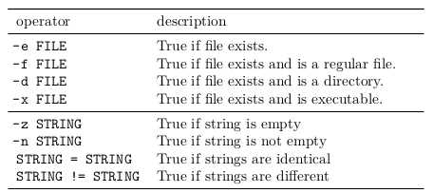
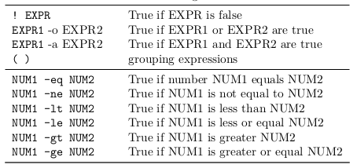
The test program
An overview of important test operators

Slide 7

The test program
test is so important that a second shorthand notation using rectangular brackets exists.
here are a few things to note:
• The space after the “[” and before the “]” is important, else the command fails.
• bash can only deal with integer comparison and arithmetic.
• The test command does not produce any output, it only returns 0 for successfultests or 1 for failing tests.

Slide 8
The test program
• Therefore we can use the test command and the && or || operators to guard other commands. E.g.
makes sure that grep is only executed if the file “file” does exist.

Slide 9
Conditionals: if
The simplest syntax of the if command is
It has the effect:
• All the commands in the list are executed.
• If the return code of the list is 0, the then-list is also executed.

Slide 10
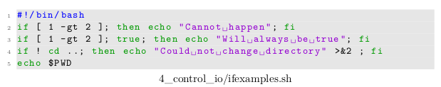
Conditionals: if
for example
Outputs

Slide 11
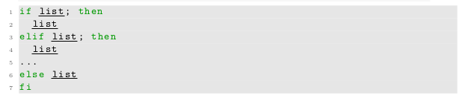
Conditionals: if
An extended syntax with optional else and elif (else-if) blocks is also available:
• Again first the if-list is executed
• If the return code is 0 (the condition is true) the first then-list is executed
• Otherwise the elif-list s are executed in turn.
• Otherwise, the else-list is executed.
• The exit status of the whole if-command is the exit status of the last command executed, or zero if no condition tested true

Slide 12
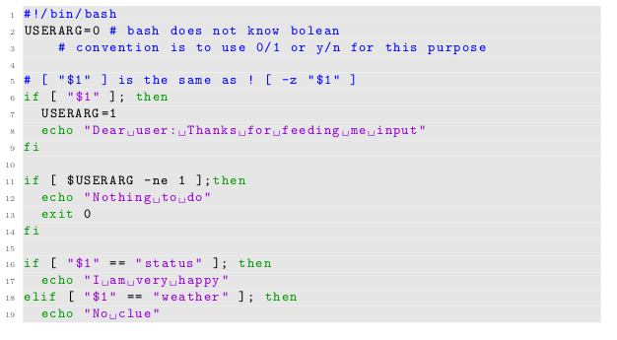
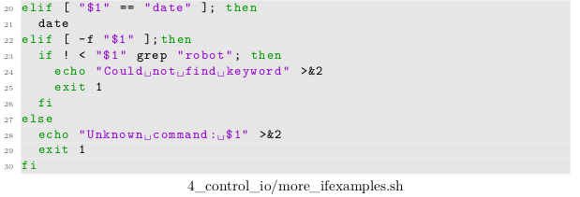
Conditionals: if
Another example

Slide 13
Conditionals: if
when run with arg "date" produces the output
when run with arg "4_control_io/more_ifexamples.sh"
when run with arg "/nonexistent"

Slide 14


Conditionals: if
A general convention is to have tests in the if-list and actions in the then-list for clarity.
Compare
And
It is easy to overlook the mv or the exit commands in such scripts.

Slide 15
Loops: while
while syntax:
• list1 and list2 are executed in turn as long as the last command in list1 gives a zero return code.

Slide 16
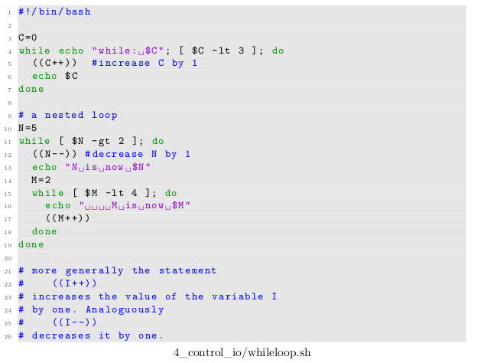
Loops: while
The output is is in the
slide

Slide 17
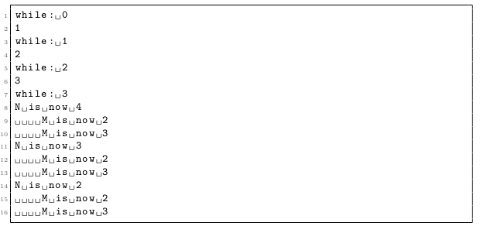
Loops: while

Slide 18
Loops: while
We can stop the execution of a loop using the break command.
This will only exit the innermost loop.

Slide 19
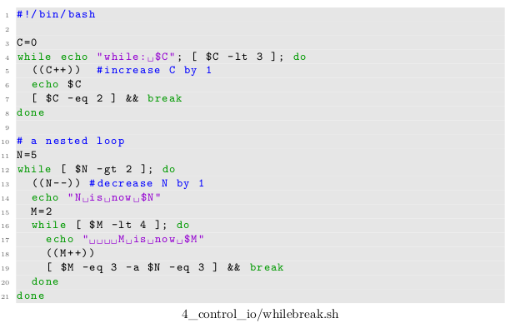
Loops: while
Output in the next
slide

Slide 20
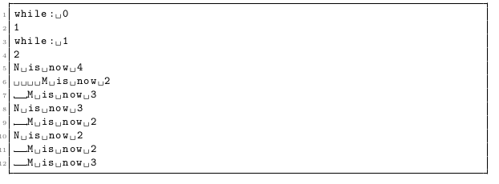
Loops: while

Slide 21
Loops: while
There also exists the command continue which jumps straight to the beginning of the next iteration,
i.e. list1 is evaluated once again and if it is true, list2 and so fourth.

Slide 22
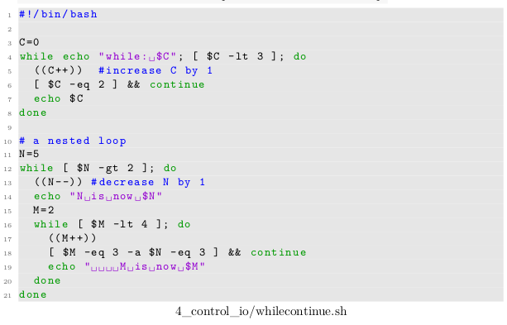
Loops: while
The continue command allows to skip some instructions in a loop.
Output in the next
slide

Slide 23
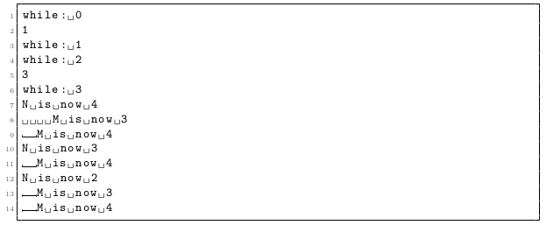
Loops: while

Slide 24
Exercise!
Exercises 4.1 - 4.5

Slide 25
Loops: for
Basic syntax:
• The variable name is subsequently set to all word s following in and the full list executed each time

Slide 26
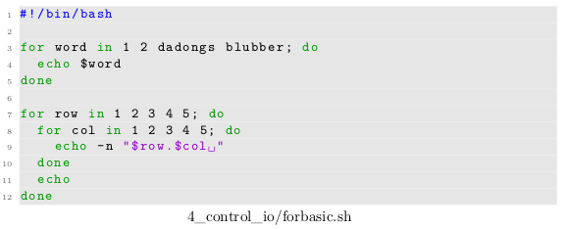
Loops: for
Output in the
Next slide

Slide 27
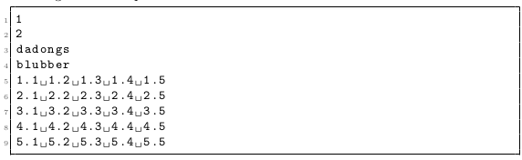
Loops: for

Slide 28
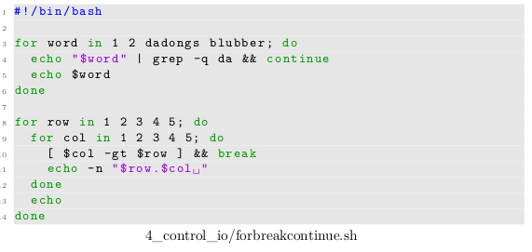
Loops: for
• We can again use break or continue in order to skip some executions of the loops:
Output In next
slide

Slide 29
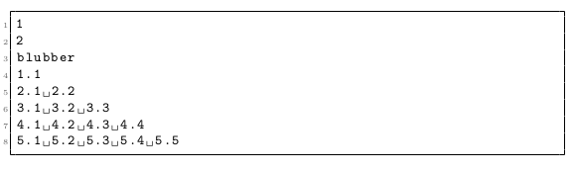
Loops: for

Slide 30
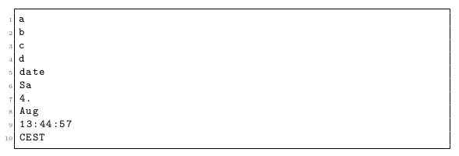
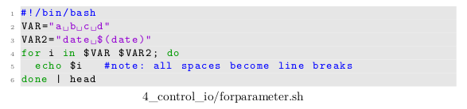
Loops: for
Common “types” of for loops
• Explicitly provided word s: What we did in the examples above.
• Parameter expansion: Output:
Script

Slide 31
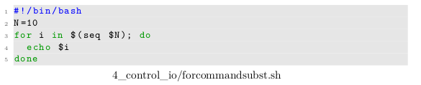

Loops: for
• Command substitution
Outputs:

Slide 32
Loops: for
• The characters * and ? are so-called glob characters and are again treated specially by the bash:
If replacement of * by zero or more arbitrary characters gives the name
of an existing file, this replacement is done before execution of the commandline.
In a similar manor ? is may be replaced by exactly one arbitrary character

Slide 33
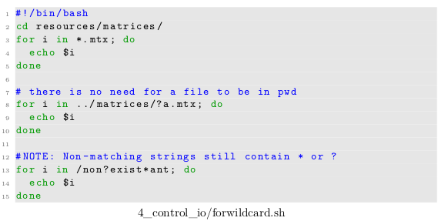
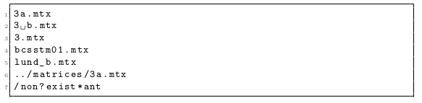
Loops: for
For example:
outputs:

Slide 34

Loops: for
• Of course combinations of these in one for loop in any arbitrary order are fine as well.
A word of warning: The paradigm
is extremely problematic, since files with spaces are not properly accounted for

Slide 35
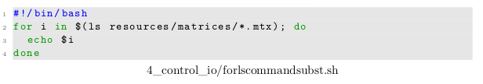
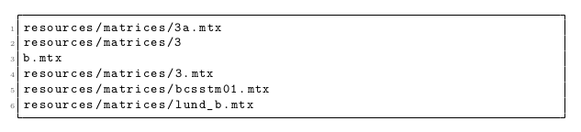
Loops: for
Compare the following results with the last example we had above
Outputs: (Can you see the problem?)

Slide 36
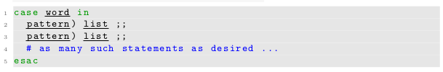
Conditionals: case
The case command has the following basic syntax:
• The command tries to match word against one of the patterns provided
• If a match occurs the respective list block is executed.
• Both the word as well as the inspected pattern s are subject to parameter expansion, command substitution, arithmetic expansion and a few others [2].
⇒ We may have variables and commands in both word and pattern .

Slide 37
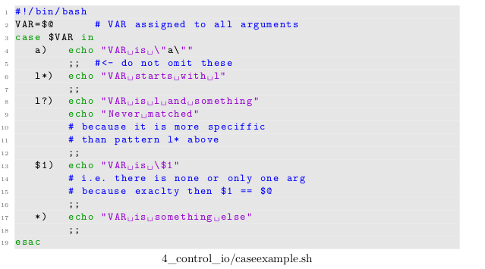
Conditionals: case
Usually in case statements we have a string containing a variable and we want to distinguish a few cases, e.g.
Output is in the
Next slide

Slide 38
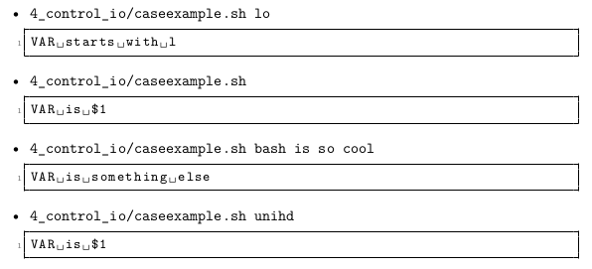
Conditionals: case
The output is

Slide 39
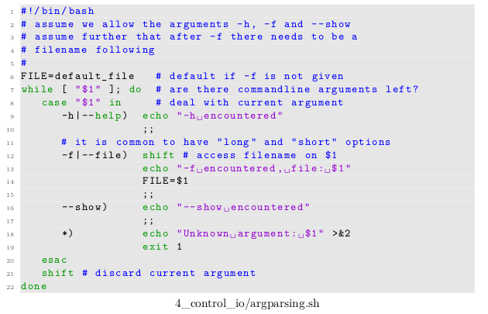
Conditionals: case
The case command is extremely well-suited in the context of parsing commandline arguments.
• A very common paradigm is While-case-shift:
• Explanation in Next slide

Slide 40
Conditionals: case
• The shift command shifts the positional parameters one place forward. After the
execution: $1 contains the value $2 had beforehand, equally 3→2, 4→3, . . .
• The while loop runs over all arguments in turn, $1 always contains the argument
we currently deal with.
• case checks the current argument and takes appropriate action.
• If a flag (like -f in this case) requires a value afterwards, we can access this value
by issuing another shift in the code executed for -f in case.

Slide 41
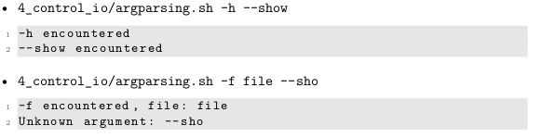
Conditionals: case
Example output

Slide 42
Parsing input using shell scripts

Slide 43
The read command
The syntax to call read is
read reads a single line from stdin and performs word splitting on it.
The first word is assigned to the variable NAME1, the second to NAME2, the third to NAME3 and so on. All
remaining words are assigned to the last variable as a single unchanged word.

Slide 44
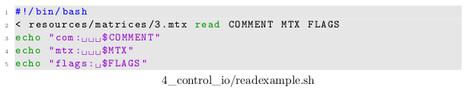
The read command
Example
The first line of resources/matrices/3.mtx is
So if we execute
We will see the output in the next slide

Slide 45

The read command
Output

Slide 46
The read command
Two options worth mentioning:
• -p STRING: Print STRING before waiting for input — like a command prompt.
• -e: Enable support for navigation through the input terminal and some other very comfortable things.

Slide 47
The read command
The return code of read is 0 unless it encounters an EOF (end of file)
This way we can easily check, whether we were able to obtain any data from the user or not.
We cannot check with the return code, however, whether all fields are filled or not.

Slide 48
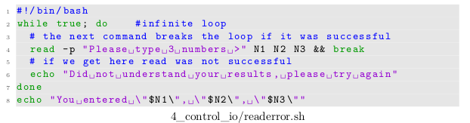
The read command
Example
We run it and enter a few numbers:
Will output

Slide 49
The read command
Another example:
Gives
On the other hand if we issue a Ctrl + D — the EOF character — we get
followed by the prompt to enter numbers again.

Slide 50
Scripts have shared stdin, stdout and stderr
Compared to writing simple one-liners there is a fundamental difference when writing a script:
All commands of the script share the same stdin, stdout and stderr (if their input/output is not redirected)
Especially when it comes to parsing stdin, this has a few consequences, which are best described by examples

Slide 51

Scripts have shared stdin, stdout and stderr
Consider the script:
If we run it like so
we might expect the output to show the content of the input file twice.

Slide 52
Scripts have shared stdin, stdout and stderr
But this is not what happens
We only get the content of resources/matrices/3.mtx once
exactly what would have happened if only a single cat was be contained in 4_control_io/cat_script.sh
This is due to the fact that cat reads stdin until nothing is left (i.e. until EOF is reached)
So when the next cat starts its execution, it encounters the EOF character straight away and stops reading.
So no extra output is produced.

Slide 53
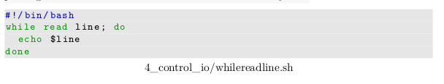
The while read line paradigm
Probably the most important application of the read command is the while read line paradigm
It can be used to read data from stdin line by line:

Slide 54
The while read line paradigm
This works because
• read tries to read the current line from stdin and stores it in the variable line.
• The line variable is then available for the loop body to do something with it.
• If all data has been read, read will exit with an return code 1, causing the loop to be exited.
Since a loop is considered as a single command by the bash shell it has its own stdin
(and stdout), meaning that
• we can redirect its stdin to read from a file

Slide 55
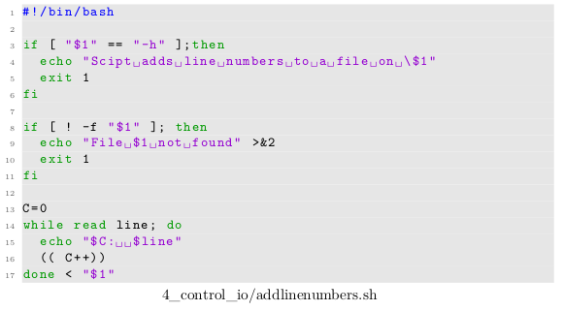
The while read line paradigm
Example:
Redirecting stdin
From file

Slide 56
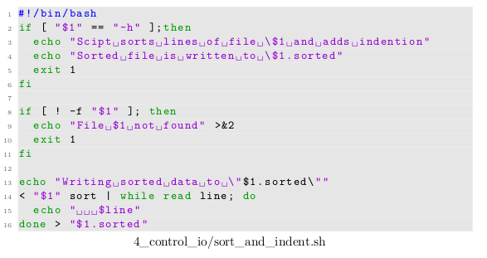
The while read line paradigm
• we can pipe the output of a command to it
• we can dump the loop’s output in a file by adding > file after the done (see
previous example)

Slide 57
Influencing word splitting: The variable IFS
we already mentioned the variable IFS in the previous lessons
• IFS is short for “internal field separator”
• This variable is considered in the word splitting whenever the shell performs wordsplitting - i.e. especially after parameter expansion and command substitution have happened.
• Its value specifies the characters at which commandline is split into individualwords during word splitting.
• Default value: <space><tab><newline>

Slide 58
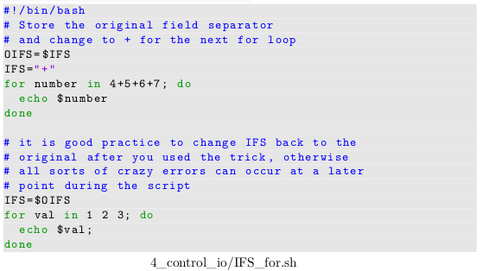
Influencing word splitting: The variable IFS
Two important use cases, which alter the IFS variable temporarily:
• Manipulation of the way for loops iterate:
Output in next slide

Slide 59
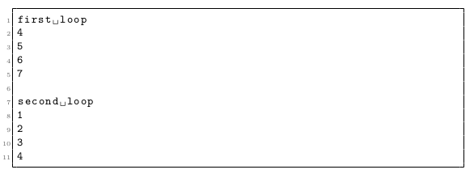
Influencing word splitting: The variable IFS
Output

Slide 60
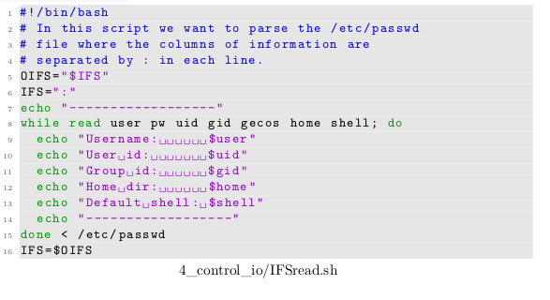
Influencing word splitting: The variable IFS
• Influencing read:

Slide 61
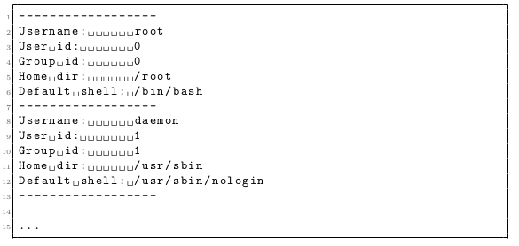
Influencing word splitting: The variable IFS

Slide 62
Conventions when scripting
To conclude this chapter we have collected a few notes about conventions
There are as usually many exceptions to each of the guidelines below. In practice try to follow each guideline, unless you have a good reason not to.

Slide 63
Conventions when scripting - Script structure
• Always use a shebang as the first line of your script.
• A block of code doing a task should have a comment explaining what goes in and what the expected result should be. This is especially true for functions
• Whenever funny bashisms are used that could make code unclear, explain whathappens and why. Think about the future you ;).
• bashisms - Chain of special characters which look like magic to someone new to shell scripting

Slide 64
Conventions when scripting - Script structure
One script should only do one job and no more. Split complicated tasks into many scripts. This makes it easier to code and easier to reuse.
Try to design scripts as filters, i.e. better read from stdin and write to stdout rather than to/from files. This simplifies code reuse, too. Think about the core Unix tools: The utilities you use most often are very likely just some kind of elaborate filter from stdin to stdout.

Slide 65
Conventions when scripting - Script structure
• Use shell functions to structure your script. Have a comment what each function does.

Slide 66
Conventions when scripting -Input and output
• Reserve stdin for data:
Do not use the read command to ask the user for data or parameters, much rather use argument parsing for this. The reason is that using read interferes with reading data from stdin
• Use helpful error messages with as much info as possible. Print them to stderr
• Reserve stderr for errors, stdout for regular output.
If you need to output two separate things, have the more important one printed to stdout, the other into a file. Even better: Allow the user to choose what goes into the file and what to stdout.
⇒ Again all of this can be summarised as “design each script as a filter”

Slide 67
Conventions when scripting - Parsing arguments
• Each script should support the arguments -h or --help.
If these arguments are provided, explain what the script does and explain at least the most important commandline arguments it supports.
• For each argument there should be a descriptive “long option” preceded by two “--”. There may be short options (preceded by one “-”).
• Do not worry about the long argument names.
You can code tab completion your script.

Slide 68
Exercise!
Exercises 4.6 - 4.15

Slide 69
Arithmetic expressions and
advanced parameter
expansions
Part 5

Slide 70
Arithmetic expansion
The arithmetic expansion is a simple, yet extremely convenient way to perform calcula tions directly in the bash.
Arithmetic expressions have the syntax
Everything within the brackets is subject to arithmetic evaluation

Slide 71
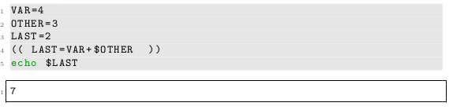
Arithmetic expansion
• The expression may be split into subexpressions using the comma ,
• The full range of parameter expansion expressions is available
One may, however, also access or assign variables without the leading $
• Exception: Positional parameters are not available

Slide 72
Arithmetic expansion
• All common operators are available:
• + - addition, subtraction
• * / % multiplication, (integer) division , remainder
• ** exponentiation
• name++ ++name name-- --name increment and decrement operators
• += -= *= /= %= Infix assignment

Slide 73
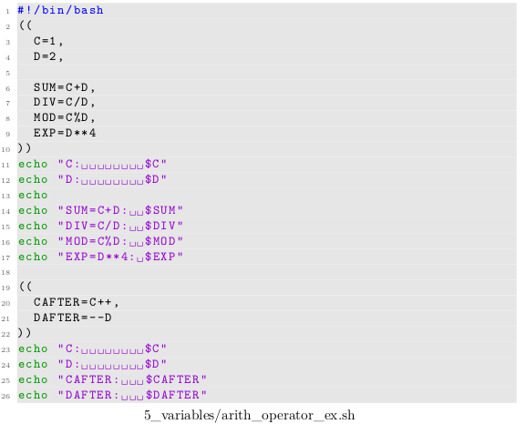
Arithmetic expansion
Output in next slide

Slide 74
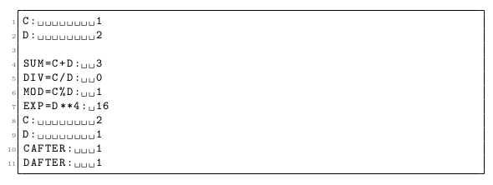
Arithmetic expansion
Output

Slide 75
Arithmetic expansion
• Brackets ( and ) can be used with their usual meaning
• Comparison and logic operators are available as well:
• == != equality, inequality
• <= >= < > se, ge, smaller, greater
• && || logical AND and logical OR

Slide 76
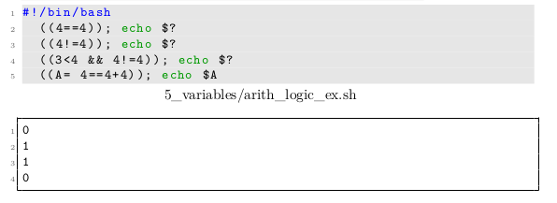
Arithmetic expansion
Internally “true” is represented by 1 and “false” by 0 (like in C)

Slide 77


Arithmetic expansion
• Expressions evaluating to 0 are considered to be false, i.e. their return code is 1.
• Expressions evaluating to another value are true, i.e. return with 0.

Slide 78
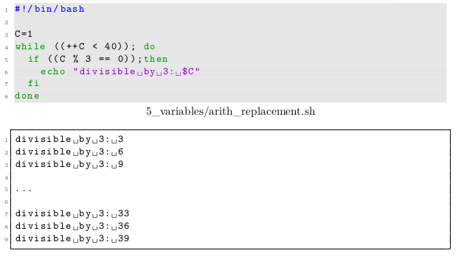
Arithmetic expansion
Especially the last two points seem a little strange at first, but they assure that arithmetic expressions can be used as a replacement for test in while or if constructs

Slide 79
Arithmetic expansion
By the means of the arithmetic evaluation the bash also supports a C-like for loop with the syntax
• expr1 , expr2 and expr3 all have to be arithmetic expressions.
• First expr1 is evaluated
• Then expr2 is repeatedly evaluated until it gives zero (“C-false”)
• For each successful evaluation both the list is executed as well as expr3 .

Slide 80
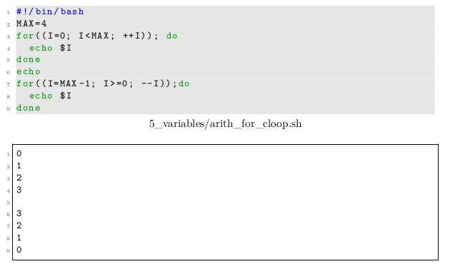
Arithmetic expansion
Example

Slide 81
Arithmetic expansion
Finally arithmetic expansion is invoked by a syntax like
• expression is subject to arithmetic evaluation as described above.
• This implies that the last arithmetic subexpression inside the (( ... )) gives the value of the arithmetic expansion. In other words the value of $((expr1, expr2)) is solely determined by expr2 .
• The whole construct is replaced by the final value the expression results in.
• The return code of (( )) is not available.
• The expression may be used just like a parameter expansion ${VAR}

Slide 82
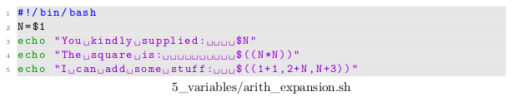

Arithmetic expansion
Example
Output:

Slide 83
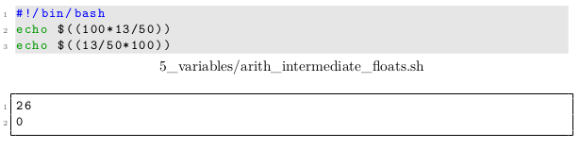
Arithmetic expansion
A big drawback on all these paradigms is that the bash only supports integer arithmetic. Even intermediate values are only stored as integers, e.g.
This means the order in which expressions are entered can sometimes become very important.

Slide 84
Arithmetic expansion
Whenever floating point arithmetic is needed one needs to use one of the tricks discussed in the next lesson

Slide 85

Non-integer arithmetic
Non-integer arithmetic, i.e floating point computations, cannot be done in plain bash.
The most common method is to use the bc terminal calculator, like so

Slide 86
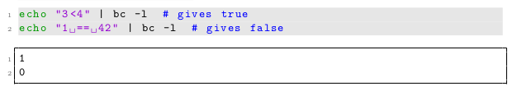
Non-integer arithmetic
The syntax is more or less identical to the arithmetic expansion, including the C-like interpretation of true and false.

Slide 87

Non-integer arithmetic
A minor difference is that ^ is used instead of ** in order to denote exponentiation.

Slide 88

Non-integer arithmetic
The format of the output can be changed using a few flags (see manpage of bc).
• For example one can influence the base (2, 8, 10 and 16 are supported)

Slide 89

Non-integer arithmetic
• or the number of decimal figures

Slide 90
Exercise!
Exercise 5.4 to exercise 5.5

Slide 91
A second look at parameter expansion
Parameter expansion is much more powerful than just returning the value of a parameter.
An overview:
• assign-default
If parameter is unset or null, set parameter to word .
Then substitute the value of parameter .
Does not work with positional parameters

Slide 92
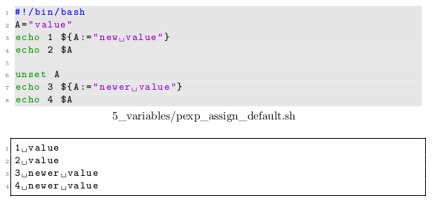
A second look at parameter expansion
Example:

Slide 93
A second look at parameter expansion
• use-default
If parameter is unset or null, substitute word , else the value of parameter

Slide 94
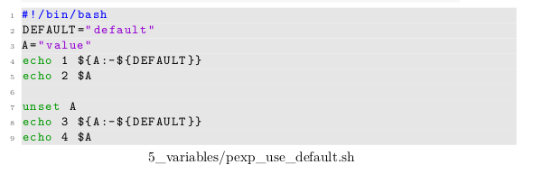

A second look at parameter expansion
Example:

Slide 95
A second look at parameter expansion
• use-alternate
If parameter is unset or null, nothing is substituted, else word is substituted.

Slide 96
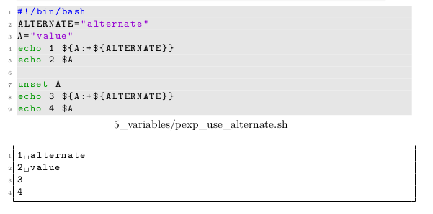
A second look at parameter expansion
Example:

Slide 97
A second look at parameter expansion
• parameter length
Expands into the number of characters parameter currently has.

Slide 98

A second look at parameter expansion
Example:

Slide 99
A second look at parameter expansion
• substring expansion
Expands into up to length characters from parameter ,
starting from character number offset (0-based). If length is omitted, all characters starting from offset are printed.
Both length and offset are arithmetic expressions.

Slide 100

A second look at parameter expansion
Example:

Slide 101
A second look at parameter expansion
• pattern substitution
parameter is expanded and the longest match of pattern is replaced by string
Normally only the first match is replaced.
If the second — global — version is used, however, all occurrences of pattern are replaced by string .

Slide 102

A second look at parameter expansion

Slide 103
Exercise!
Exercise 5.6

